Slide 1
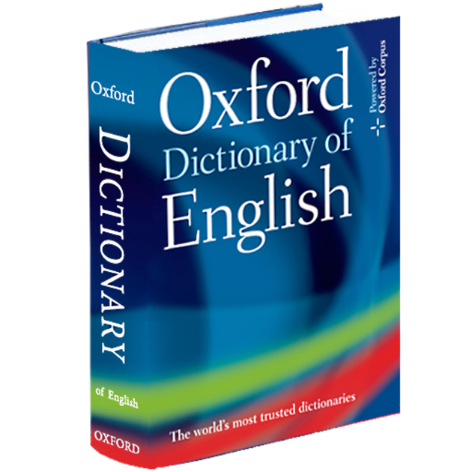
5th November
The act of defining, or of making something distinct, or clear; a statement of the meaning of a word of phrase
DEF
IN
DE – thoroughly
FIN – ending, limit, boundary
TION – act, process, result
I
TION
Finale
Devotion
Financial

Slide 2
12th November
Logically ordered and./or following the same pattern; always behaving or happening in a similar way
CON
SIS
CO/CON – together, with , altogether
SIST – standing
ANT/ENT – ing (action)
TENT
Irresistible
Persist
Absorbent

Slide 3
19th November
Someone’s or something’s ability to develop, achieve or succeed; having the power to do or develop into something
PO
TEN
POTENT – power
AL – to do with
TIAL
Equipotential
Initial
Potency

Slide 4
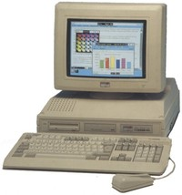
26th November
Not the result of new ideas; having qualities taken, developed or copied from something else
DER
I
DE – away, down, reverse
RIV – flowing
IVE – tending to, by nature
VAT
IVE
Rival
Deviate
Attractive

Slide 5
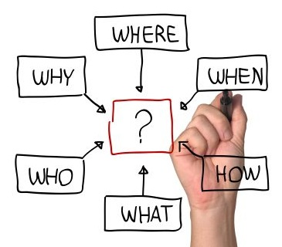
3rd December
Relating to the surrounding circumstances that help to explain the meaning of a situation, statement, word, image etc.
CON
TEX
CO/CON – together, with, altogether
TEXT – weaving
AL – to do with
TU
AL
Subtext
Consideration
Texture

Slide 6
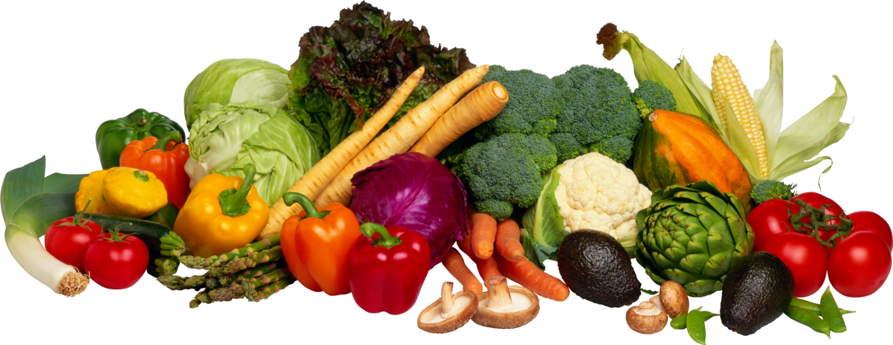
10th December
Doing good to or for something; favourable, supportive
BEN
E
BENE – good, kind
FIC/FI/FY – making
AL – to do with
FI
CIAL
Gratification – Benevolent - Personification

Slide 7
17th December
Free to be used; free to do something
AV
AVAIL – of use or value
ABLE/IBLE – can be done
AIL
ABLE
Prevail
Irretrievable
Believable

Slide 8
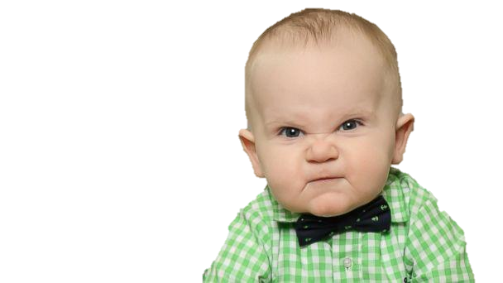
7th January
Having or showing dislike of other people
MIS
AN
MIS – wrong/bad
ANTRHOP – human
IC – to do with
THROP
IC
Misogynist
Anthropology
Pandemic

Slide 9
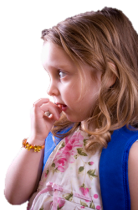
14th January
Hesitant or fearful
AP
PRE
AP – to/towards
PREHEND – grasping
IVE – tending to
HEN
SIVE
Comprehensive
Approximate
Reprehend

Slide 10
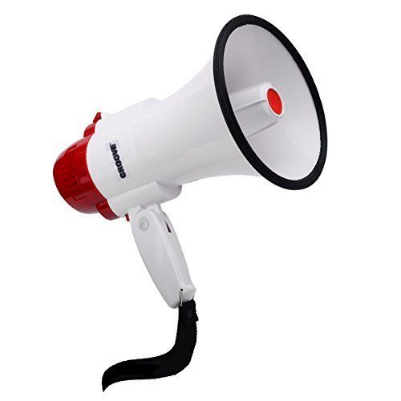
21st January
Lies or stories spread with the aim of influencing the opinions of others politically.
PROP
A
PRO – for/forwards
PROPAGATE – cause to grow or spread
GAN
DA
Promote
Protracted
Propagandist

Slide 11
28th January
The act of remembering or showing respect for a person or people who have died.
RE
MEM
RE – again
MEMB – mindful
ANCE – act/process
BRANCE
Commemorate
Immemorial
Recollection

Slide 12
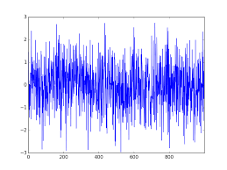
4th February
An unpleasant and chaotic sound
CAC
O
CAC – bad
PHON – sound
PHO
NY
Phonic
Cacophonous
Microphone

Slide 13
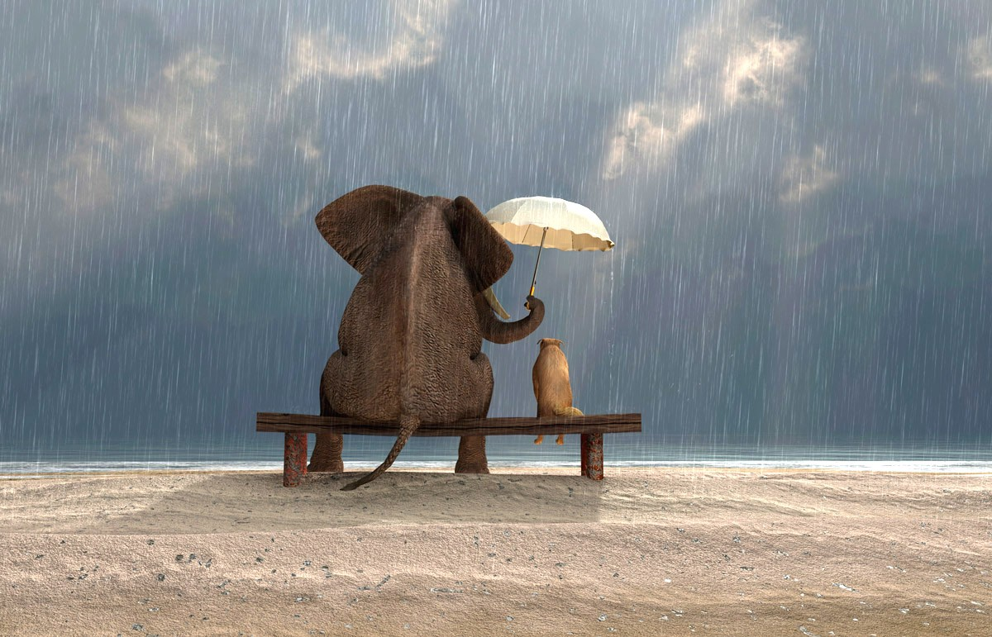
11th February
Wishing to do good/be kind
BEN
BEN – well/good
ENT – the act of
EV
OL
ENT
Emergent
Beneficial
Benedictions

Slide 14
18th February
To wander away from the main topic
DI
GRESS
DI/DIS – away/down
GRESS – to step
Regress
Aggressive
Disappear

